Slide 1
Human Computer Interaction
Usability Engineering

Slide 2
Today’s Lecture
Attributes of system acceptability
Usability and User Experience
Interdisciplinary Nature of HCI
Target Market & User Classification

Slide 3
Usability Engineering
An iterative process to improve usability of a system.

Slide 4
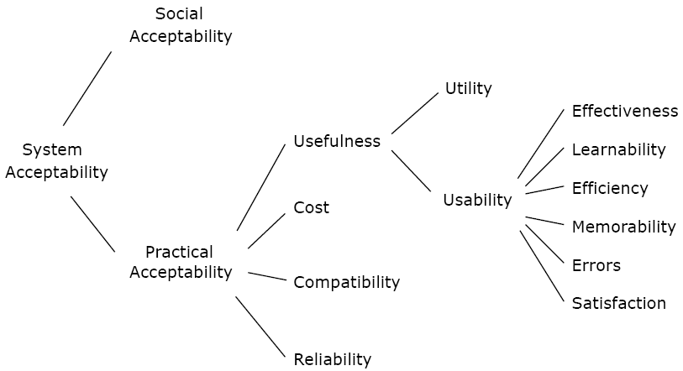
Attributes of System Acceptability
Notes:
Reference book
Usability Engineering
By Jakob Nielsen
Utility is the question of whether the functionality of the System in principle can do what is needed, and usability is the question of how well users can use that functionality.
https://books.google.com.pk/books?id=95As2OF67f0C&pg=PA25&lpg=PA25&dq=a+model+of+the+attributes+of+system+acceptability+by+nielsen&source=bl&ots=3aAFCofs0r&sig=Lu7rHDREEZ_Ig3pxUlwOWQ50dK0&hl=en&sa=X&ei=t2onVdvVCcneaLDfgiA&redir_esc=y#v=onepage&q=a%20model%20of%20the%20attributes%20of%20system%20acceptability%20by%20nielsen&f=false

Slide 5
Utility
Users can do what they need to or want to do.

Slide 6
Utility
High utility
  Scientific calculator provides many mathematical operations, built-in formulae, and is programmable
Low utility
  Software drawing tool does not allow free-hand drawing but only supports polygon shape drawing

Slide 7
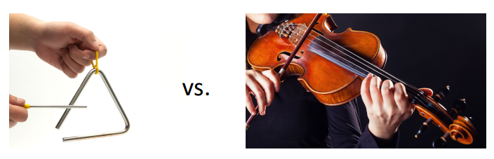
Usability
More than just ‘easy to use’

Slide 8
Usability
The ISO defines usability as
“the extent to which a product can be used by specified users to achieve specified goals with effectiveness, efficiency and satisfaction in a specified context of use.”
ISO [1998]. Ergonomic Requirements for Office Work with Visual Display Terminals (VDTs) – Part 11: Guidance on Usability
(ISO 9241-11:1998)

Slide 9
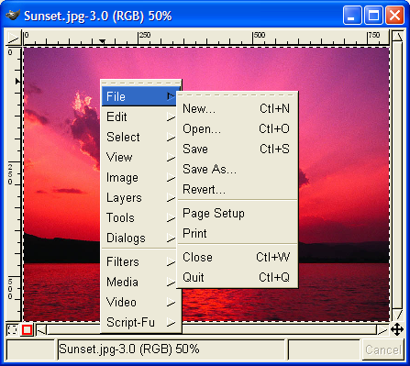
Usability?
Gimp windows had no menus – instead, right-click to get a popup menu and navigate further. Is this a fast way to select commands?
Notes:
Gimp is an open-source image editing program, comparable to Adobe Photoshop. Gimp’s designers made a strange choice for its menus. Gimp windows have no menu bar. Instead, all Gimp menus are accessed from a context menu, which pops up on right-click.
This is certainly inconsistent with other applications, and new users are likely to stumble trying to find, for example, the File menu, which never appears on a context menu in other applications. (I certainly stumbled as a new user of Gimp.) But Gimp’s designers were probably thinking about expert users when they made this decision. A context menu should be faster to invoke, since you don’t have to move the mouse up to the menu bar. A context menu can be popped up anywhere. So it should be faster. Right? Wrong….

Slide 10
1. Learnability
How easy is the system to learn for a novice user?
How we learn a New User interface?
Notes:
Certainly, there are some systems for which one can afford to train users extensively to overcome a hard-to-learn interface, but in most cases, systems need to be easy to learn.

Slide 11
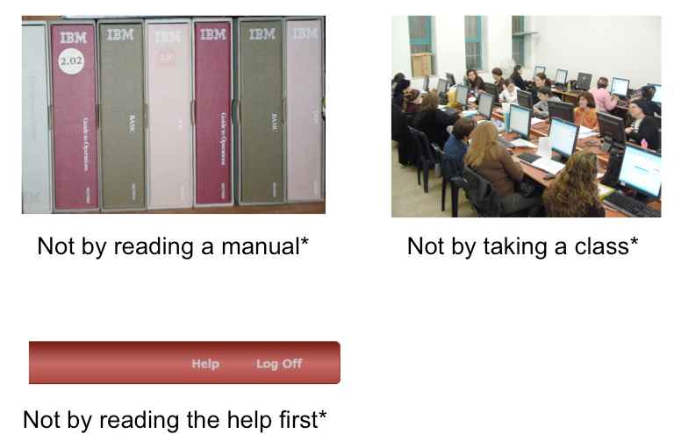
How we learn a New User interface?
Notes:
When computers first appeared in the world, there were some assumptions about how people would learn how to use the software. Programmers assumed that users would read the manual first – obviously not true. Companies assumed that their employees would take a class first – not always true. Even now that we have online help built into virtually every desktop application, and web page help often just a search engine query away, users don’t go to the help first or read overviews.
All these statements have to be caveated, because in some circumstances – some applications, some tasks, some users – these might very well be the way the user learns. Very complex, professional-level tools might well be encountered in a formal training situation – that’s how pilots learn how to use in-cockpit software, for example. And some users (very few of them) *do* read manuals.
Nearly all the general statements we make in this class should be interpreted as “It Depends.” There will be contexts and situations in which they’re not true, and that’s one of the complexities of UI design.

Slide 12
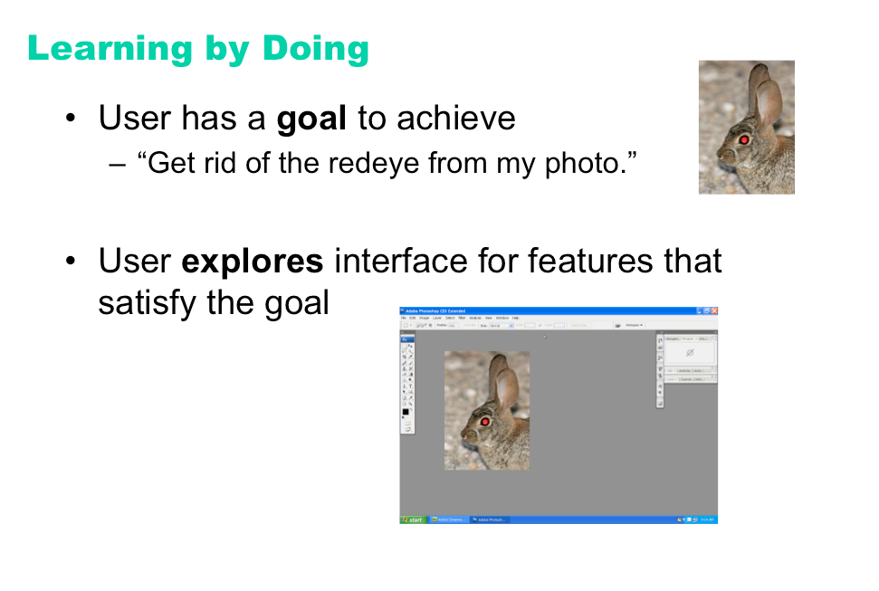
People Learn by Doing
Notes:
So users don’t try to learn first – instead, they typically try to do what they want to do, and explore the interface to see if they can figure out how to do it. This practice is usually called learning by doing, and it means that the user is starting out with a goal already in mind; they are more interested in achieving that goal than in learning the user interface (so any learning that happens will be secondary); and the burden is on the user interface to clearly communicate how to use it and help the user achieve their first goal at the same time.

Slide 13
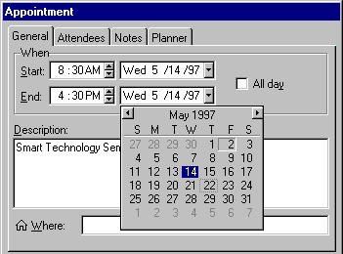
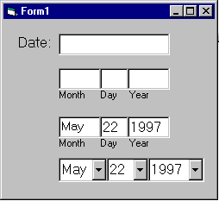
Input format, example and default helps learnability

Slide 14
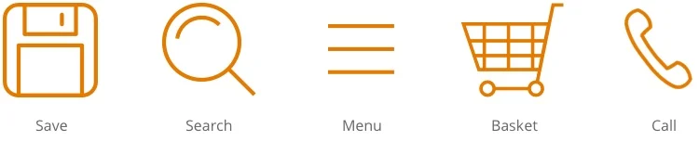
Use familiar icons to improve learnability

Slide 15
How will we measure learnability?
Time
No of retries
No of errors produced
Can time be solely relied upon as a measurement?

Slide 16
2. Memorability
How easy a system is to remember how to use, once learned for a returning user.
Notes:
Once a user has taken the time to learn how to navigate a website and find what they are looking for; they need to be able to remember how to do it when they come back. A website needs to have high memorability. Memorability is a measure of how easy a website is to remember after a substantial time-lapse between visits.
If a website has good learnability and memorability, visitors are sure to keep coming back for more. When we are designing a website we try to maximize the memorability by creating logical steps and consistent design throughout the site.

Slide 17
Memorability
If a website has good learnability and memorability, visitors are sure to keep coming back for more.
When we are designing a website
  create logical steps
  consistent design throughout the site
  Meaningful icons etc.

Slide 18
How will we measure memorability?
Time
No of retries
No of errors produced

Slide 19
3. Efficiency
Refers to the way a system supports expert/experienced users in carrying out their tasks.

Slide 20
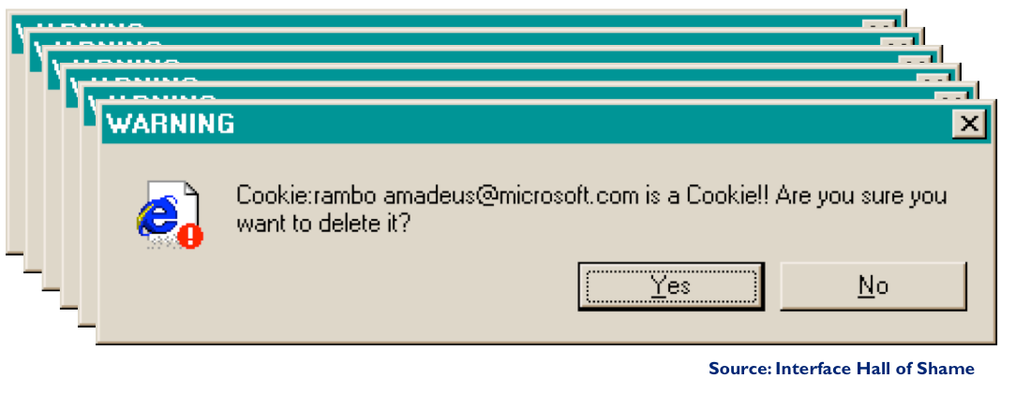
Efficiency
Notes:
Is it giving enough information about the error so that user can make a decision?
Suppose you selected all cookie files and selected to delete them in one go. You get one dialogue to delete each of them. What button is missing?

Slide 21
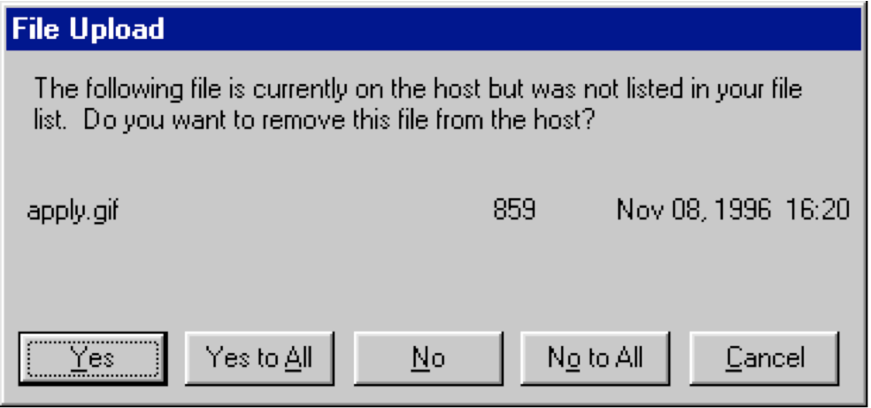
Efficiency
Notes:
Local file upload to remote site.
What if you know there is a a file you don’t want to delete. What would you do ?

Slide 22
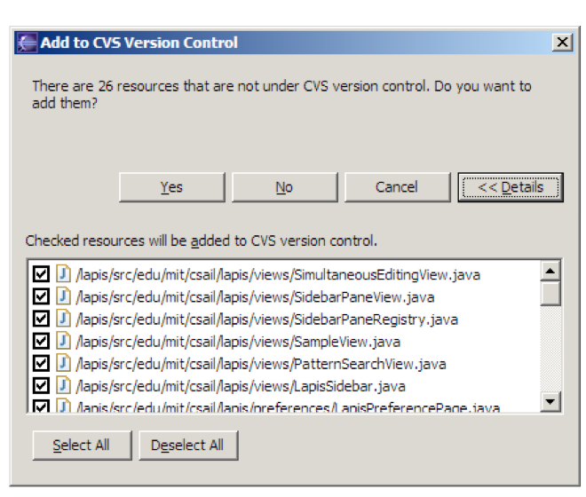
Efficiency

Slide 23
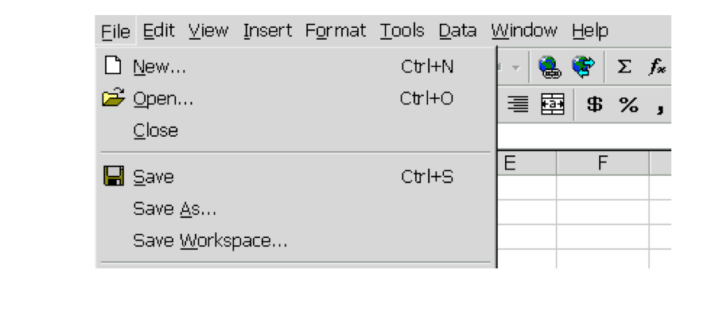
Keyboard Shortcuts

Slide 24
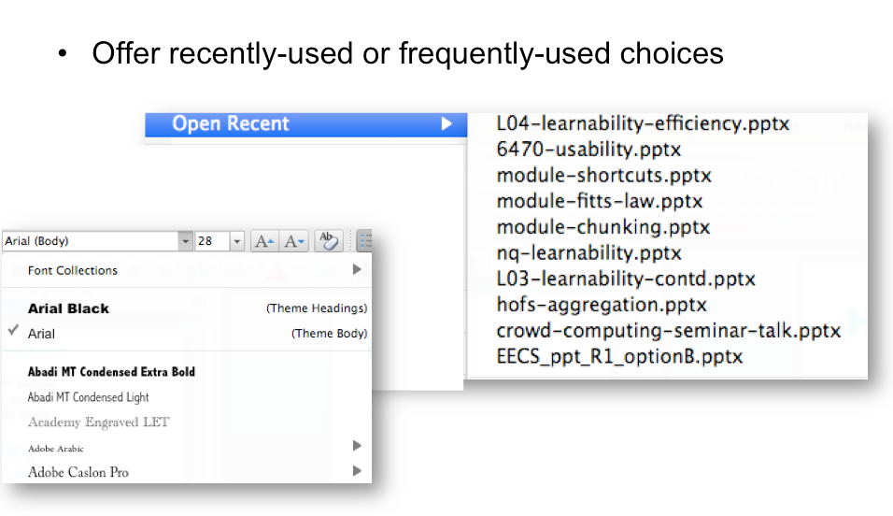
History

Slide 25
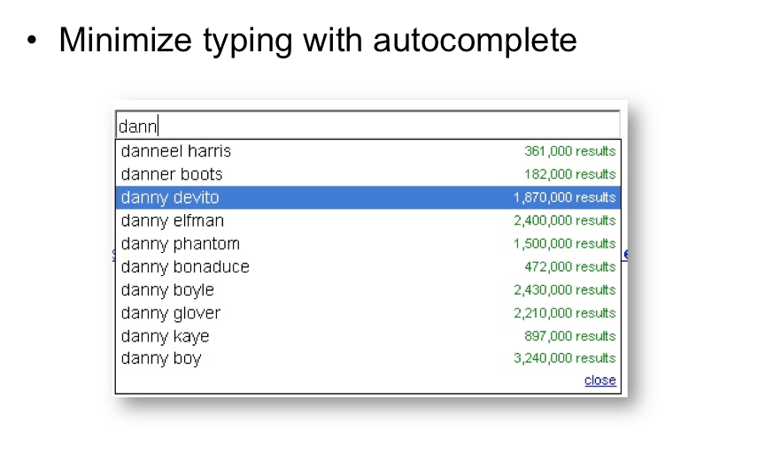
Autocomplete

Slide 26
How will we measure efficiency?
Time

Slide 27
4. Effectiveness
Refers to how good a system at doing what it is supposed to do with an experienced user
Effectiveness is the completeness and accuracy with which users achieve specified goals

Slide 28
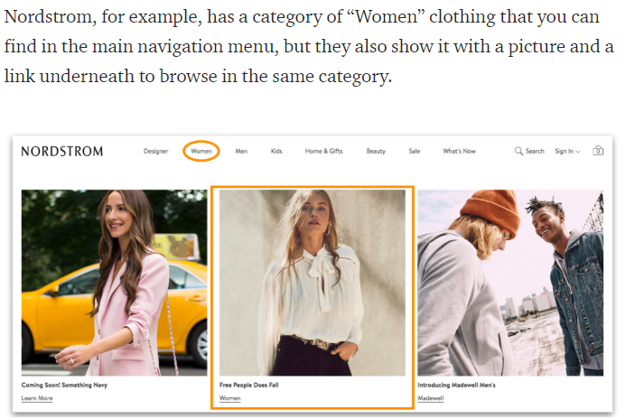
4. Effectiveness
Notes:
Rather then giving a menu of clothing(only) if your website gives you the accurate thing to choose from menu it will be rather more effective.
Effectiveness if all about accuracy and completeness.
Effectiveness is about the high degree of accuracy under which users can complete their goals. The product has to be able to support the user while performing tasks.
Effectiveness is about the high degree of accuracy under which users can complete their goals. The product has to be able to support the user while performing tasks.

Slide 29
How will we measure effectiveness?
Did the user got his task done completely?

Slide 30
5. Error Prevention
Refers to how good a system is to help users when something fails.
What can be different steps for this ?
Notes:
Certainly, there are some systems for which one can afford to train users extensively to overcome a hard-to-learn interface, but in most cases, systems need to be easy to learn.

Slide 31
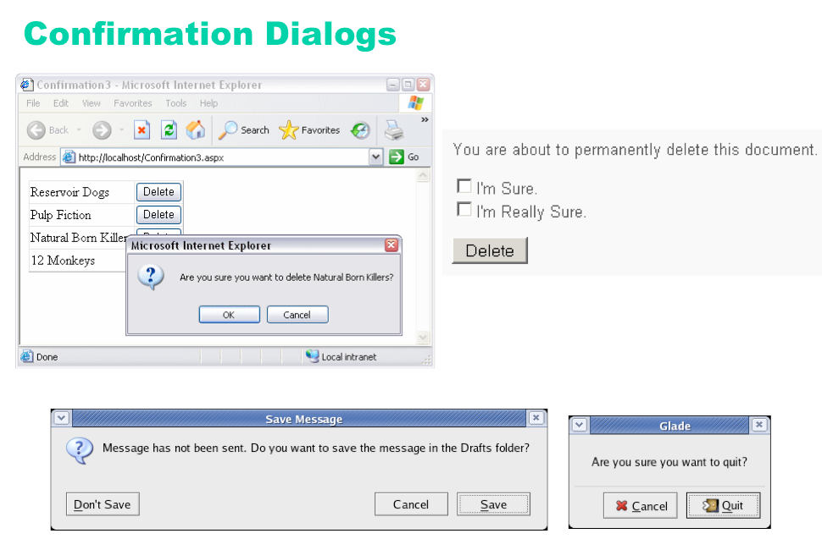
Error Prevention
Notes:
An unfortunately common strategy for error prevention is the confirmation dialog, or “Are you sure?” dialog.
It’s not a good approach, and should be used only sparingly, for several reasons:
• Confirmation dialogs can substantially reduce the efficiency of the interface. In the example above, a
confirmation dialog pops up whenever the user deletes something, forcing the user to make two button presses
for every delete, instead of just one. Frequent commands should avoid confirmations.
• If a confirmation dialog is frequently seen – for example, every time the Delete button is pressed – then the
expert users will learn to expect it, and will start to include it in their habitual procedure. In other words, to
delete something, the user will learn to push Delete and then OK, without reading or even thinking about the
confirmation dialog! The dialog has then completely lost its effectiveness, serving only to slow down the
interface without actually preventing any errors.
In general, reversibility (i.e. undo) is a far better solution than confirmation. Even a web interface can provide
at least single-level undo (undoing the last operation). Operations that are very hard to reverse may deserve
confirmation, however. For example, quitting an application with unsaved work is hard to undo – but a welldesigned
application could make even this undoable, using automatic save or keeping unsaved drafts in a
special directory.

Slide 32
Error Prevention
Error messages
Error handling
Put constraints to avoid errors
Support undo
Confirmation dialogue

Slide 33
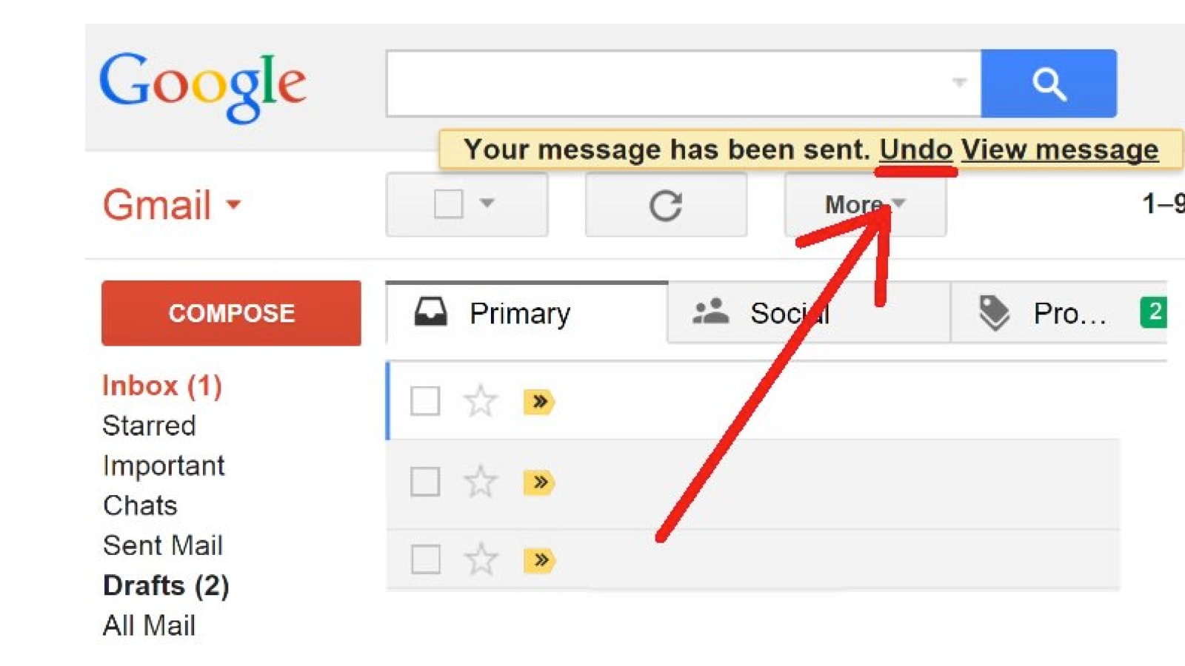

Slide 34
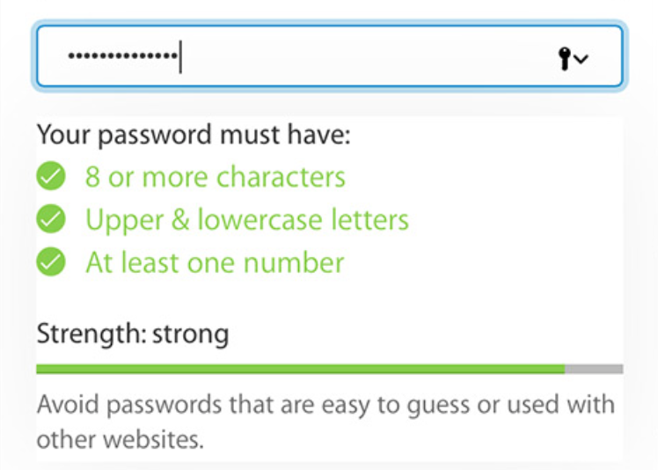

Slide 35
How will we measure error prevention?
How many errors were produced?
How many errors messages were understood by the user?
How many users exit the errors gracefully?

Slide 36
6. Satisfaction
Satisfaction refers to how pleasant it is to use the system
How can we measure this?

Slide 37
User Experience – A Definition
The user experience is the holistic combination of everything that the user
  Sees
  Touches
  Feels
  Interacts with

Slide 38

Usability
User Experience
Interface
Interaction
Computer
Human

Slide 39
User Experience Goals
Enjoyable
Fun
Entertaining
Helpful
Motivating
Aesthetically Pleasing
Supportive to Creativity
Rewarding
Emotionally Fullfilling

Slide 40
Measureable Usability Attributes
Learnability: ease of learning for novice users.
Efficiency: steady-state performance of expert users.
Errors: error rate for minor and catastrophic errors.
Memorability: ease of using system intermittently for casual users.
Effectiveness: completeness with which expert users achieve their goal.
Satisfaction: how satisfying a system is to use, from user’s point of view.
Notes:
Learnability: The system should be easy to learn so that user can rapidly start getting some work done with the system.
Efficiency: Once users have learned the design, how quickly can they perform tasks?
Memorability: When users return to the design after a period of not using it, how easily can they reestablish proficiency?
Errors: How many errors do users make, how severe are these errors, and how easily can they recover from the errors?
Satisfaction: How pleasant is it to use the design?

Slide 41
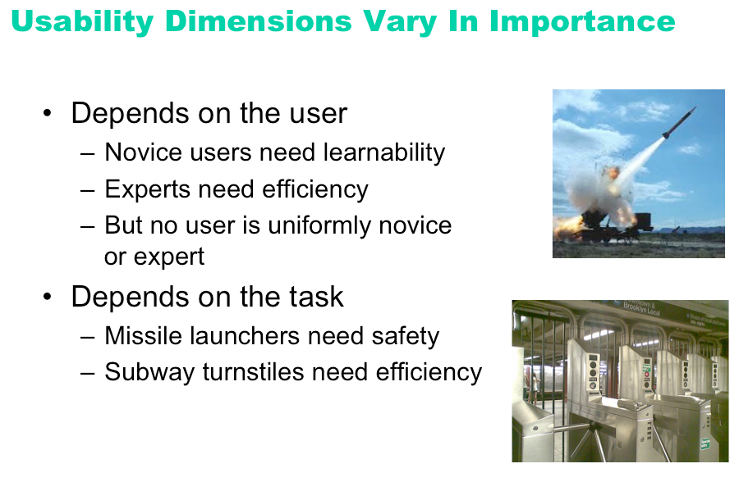

Slide 42
Context is Important
  A web site used only once by millions of people has such a strong need for _______________________
  A stock trading program used on a daily basis by expert traders, for whom lost seconds translate to lost dollars, must put_______________ above all else.
  A military application may needs the ___________the most
Researching the user and the context is thus very important
Notes:
ease of learning, in fact zero learning
Efficiency
stability and security

Slide 43
Context is Important
  For something like a bank automated teller machine (ATM) or information kiosk in a museum, __________ might be the major focus of usability practitioners.
  For complex systems such as jet planes, railway systems, and nuclear power plants, the critical dimensions might be __________________.
Notes:
If you can’t remember the proper code to use when an alarm goes off in a nuclear power plant, a catastrophic event affecting many people over several generations might occur.
learnability, memorability
Effectiveness, error management

Slide 44
What do you think are the key usability goals and user experience goals for following examples?
A mobile device that allows young children to communicate with each other and play collaborative games
A video and computer conferencing system that allows students to learn at home
An online community that provides support for people who have recently been bereaved
Notes:
Easy to use, effective efficient, easy to learn , fun and entertaining
Easy to learn, effective , efficient , motivating and rewarding
Easy to learn easy to use, motivating, emotionally satisfactory

Slide 45
Recap
Q: Which of these is not attributes of usability?
Learnability
Efficiency
Effectiveness
Utility

Slide 46
Q: Learnability should be defined as
Ease of learning for novice users.
Ease of learning for intermediate users.
Ease of learning for expert users.
Ease of using system intermittently for casual users.

Slide 47
Q: Effectiveness should be defined as
Number of utilities present in the system
Completeness with which users achieve their goal.
No of steps taken to perform the task for Expert user
Time taken to perform the task for expert user

Slide 48
Q: Errors should be defined as
Number of errors while performing task by Expert user
Number of errors while performing task by novice user
Number of errors while performing task by intermediate user
Number of errors while performing task by any user

Slide 49
Q: Satisfaction should be defined as
How much functionalities system is providing to perform
How satisfying a system is to use, from user’s point of view.
System is available 24*7
All of the above

Slide 50
Q: How user learn the system
Learn by doing
Learn by watching
Learn by reading manuals
All of the above

Slide 51
Q: What do you think are the key usability goals and user experience goals a mobile device that allows young children to communicate with each other and play collaborative games
Easy to learn, effective, efficient, easy to learn , fun and entertaining
Easy to learn, effective , motivating and rewarding
Easy to learn, easy to use, motivating, emotionally satisfactory
Easy to use, memorable, motivating, helpful

Slide 52
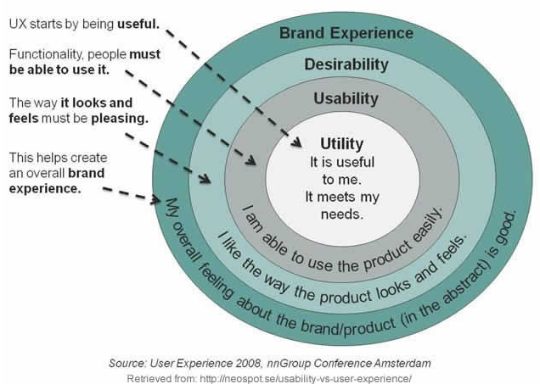

Slide 53
Self Study

Slide 54
Interdisciplinary Nature of HCI
HCI is understanding the Complex Relationship between Human and Computers
Two Distinct “Species”
Successful Integration is dependent upon the a better understanding of both Species
Hence HCI borrows and establishes its roots in Disciplines concerned with both

Slide 55
Interdisciplinary Nature of HCI – Human Side
Cognitive Psychology
  Understanding human behavior and mental processes
Social Organizational Psychology
  Studying nature and causes of human behavior in social context
Ergonomics and human Factors
  It is the study of designing equipment and devices that fit the human body and its cognitive abilities.
Linguistics
  Linguistics is the scientific study of language
Sociology
  Sociology is the academic study of social behavior, its origins, development, organization, and institutions.

Slide 56
Interdisciplinary Nature of HCI – Computer Side
Computer Science
  Provides knowledge about capability of technology
  Developing techniques to support software design, development and maintenance
Artificial Intelligence
  Intelligent Computing concerned with simulating human behavior
  HCI – development of expert and tutoring systems
Engineering and Design
  Engineering takes finding of sciences and utilizes them in the production of artifacts
  Design contributes creative skills and knowledge to this process

Slide 57
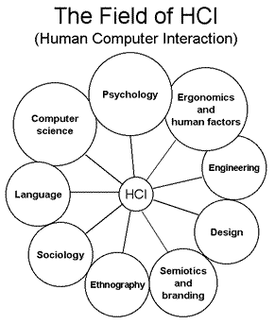
HCI: AN Interdisciplinary Area

Slide 58
Reference Material
Interaction Design: Beyond Human - Computer Interaction (3rd ed.), by Yvonne Rogers, Helen Sharp, Jenny Preece. Wiley, 2011.
Human-Computer Interaction (3rd ed.), by Alan Dix - Janet Finlay - Gregory Abowd - Russell Beale PRENTICE HALL 2004
Usability Engineering edited by Jakob Nielsen

Slide 59
Target Market
A particular group of consumers at which a product or service is aimed.
They have certain characteristics as demographics or psychological and behavioral patterns.
"schools are a key target market for the educational apps"

Slide 60
Target Market
Example:
McDonald’s targets students, employees, and professionals in the age group of 8 to 45 years belonging to low & middle-income groups and having an easy-going and careless personality

Slide 61
Target market
Age – What is the general age range of your current customers?
Gender – Are your current customers mostly male or female?
Income – How much money do your customers have to spend on your products or services? Are they able to make repeat purchases or do they need to save up for your product?
Location – Where do your customers live and what time zone are they in? What are some cultural issues that are unique to their location
Behavior – How do your customers hang out online? Which pages or brands do they follow and what is their preferred social media platform?
Lifestyle – How do your customers spend their free time?
Values – What are their general beliefs and values
Notes:
Age – What is the general age range of your current customers? Knowing this data will help you when choosing your target segment in social media ads.
Gender – Are your current customers mostly male or female? This will help you better understand their specific needs and wants that are perhaps unique to their gender.
Income – How much money do your customers have to spend on your products or services? Are they able to make repeat purchases or do they need to save up for your product? Are there any financial barriers that you need to address?
Location – Where do your customers live and what time zone are they in? What are some cultural issues that are unique to their location (ie products targeting American football versus real football
Behavior – How do your customers hang out online? Which pages or brands do they follow and what is their preferred social media platform? What kinds of content do they consume and can you incorporate that into your content marketing strategy?
Lifestyle – How do your customers spend their free time? What kinds of products or services do they need to support those hobbies?
Values – What are their general beliefs and values? Does this influence their brand loyalty, where they purchase products or what kinds of products they purchase

Slide 62
User Classification
There are 3 main types of user
Novice
Knowledgeable / intermittent user/ Casual user
Expert / frequent user
Users can however, be classified in any other way that is appropriate to the system being built. (user classes)
Some users may have keyboard skills, others not.
Some users may have knowledge of other similar systems, others not.
Notes:
User classes will differ based on the type of software you are writing, and the audience it is designed for. For example, I created a database application which had two user classes: traders and administrators.

Slide 63
User Classes
What will be user classes for UCP portal ?
What will be user classes for ATM ?
What will be user classes for facebook?

Slide 64
User Classes
When two user groups are there who behave differently with the system or system behaves differently with them.

Slide 65
Identify user classes
E-commerce website
Notes:
Seller & buyer, buyer-> boys and girks→ boys need efficiency and effectiveness. Girls need?? Learnability same.

Slide 66
User Classification
The advantages of classification mean that generalizations can be made about users and their needs.
This doesn’t necessarily mean that the best system has been designed for every individual.
It means that the system has been designed to fit the a user group

Slide 67
User classification
One of the advantage is at the time of installation one can set profile + no of options.

Slide 68
Class Activity

Slide 69
Measuring Usability Attributes
Learnability:
  pick novice users of system, measure time to perform certain tasks.
Efficiency:
  decide definition of expertise, get sample expert users (difficult), measure time to perform typical tasks.
Errors:
  count minor and catastrophic errors made by users while performing some specified task. For example, number of deviations from optimal click path.
Notes:
Effectiveness
The extent to which users can achieve their task goals.
Effectiveness measures the degree of accuracy and/or completion
e.g.,if desired task goal is to locate information on a web site then:
Effectiveness= success of user in locating the correct data
If the outcome is ALL or NOTHING then effectiveness is an absolute value
-User either locates info or does not...
If outcome can be graded, (user can be partially right) then effectiveness should be measured as a scale
-As a %, or a score from 1 (poor) to 5 (complete)
Scale should be determined by evaluator in conjunction with developers and users
Efficiency
Measures resources used to perform task
i.e., time, effort, cost,
In case of Web site use, efficiency might equal time taken to complete a task or the navigation path followed etc.
Time taken to complete task
Compared across tasks, across users or against a benchmark score
Number of steps taken
Number of deviations from ideal path
Such variables are frequently highly positively correlated - but they needn’t be.
Satisfaction:
Measures the affective reaction (likes, dislikes, attitudinal response) of users to the application
Assumed to be influenced but not the same as effectiveness or efficiency e.g.,
2 applications with equal effectiveness, and efficiency, may not be equally satisfying to use
or What users like might not be what they need!

Slide 70
Measuring Usability Attributes
Memorability:
  get sample casual users (away from system for certain time),
Effectiveness:
  decide on definition of success. For example, number of substitution words spotted in a text, or binary measure of success (order completed or not).
Satisfaction:
  ask users’ subjective opinion (questionnaire), after trying system for real task.

